Slide 1
Five Tactics to Increase Business Profitability
January 29, 2013

Slide 2
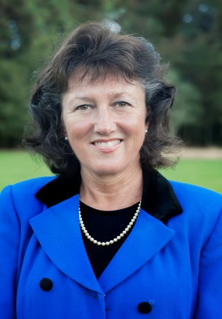
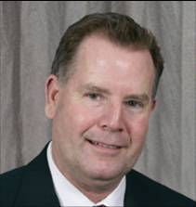
A Few Details…
All will be muted until Q&A session
Polls
Question & Answer session
Survey feedback after webinar
Webinar will be recorded and available on website
Presenters:
Jennifer Vessels
CEO – Next Step
James Downes
Sr. Director – BBK

Slide 3
Today’s World
UNCERTAINTY
QUESTIONS
GROWTH AND
OPTIMISM

Slide 4
Poll

Slide 5
Customer Driven Success
Vision
Determination and Development
Execution
Market
Customers
Operational Processes
Human Capital
Notes:
www.nextstepgrowth.com
5

Slide 6
Time to Sharpen the Saw?
Today’s economic environment demands that companies sharpen their execution ….Stephen Covey would say “Sharpen Your Saw”
In an up cycle, you can get away with less than perfect execution, because life is good
In a downturn, every dollar counts and waste and inefficiency in your system of work can mean the difference between profit and loss

Slide 7
Top Grade Your Staff

Slide 8
Pareto Rule Applied To Your People
80/20 Rule…what is it?
Do 20% of your people drive most of your results?
Commercial Bank Example
Strength of management is not putting up with mediocre performers
Client had 7,000 employees
100 people at a total cost of $70k= $7 million in wasted salaries
Warehouse Distributor
Owner Fired 37 of his 40 employees
Bank engaged BBK to assist
Hired all 37 employees back
After Thirty day assessment period

Slide 9
Top 5 Hiring Mistakes
1. Lack of agreement of expectations
2. Settled for less than 100%
3. “Sold the candidate”
4. Not a complementary fit in team
5. Not the right type of sales person

Slide 10
Hiring Sales People
Considerations:
How customers buy
Sales strategy and need
Size and type of buyer
Look for:
Hunters or farmers
Experience selling to your customer base
Contacts
References
Notes:
Notes
__________________________________________________________________________________________________________________________________________________________________________________________________________________________________________________________________________________________________________________________________________________________________________________________________________________________________________________________________________________________________________________________________________________________________

Slide 11
Poll
Sourcing
Behavioral
Interviews
Onboarding
Style Assessment
Reference
Checks

Slide 12
Hiring Best Practices
Sourcing
Behavioral
Interviews
Onboarding
Preparation
for Offer
Style Assessment
Reference
Checks

Slide 13
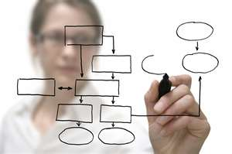
Map Your Processes

Slide 14
Three Customer Types
Strategic Value Customers
(leveraging supplier’s enterprise core competencies)
Extrinsic Value Customers
(buying beyond product value)
Create extraordinary
value for a few large
customers
Create new value
through sales effort
Increase
Benefits
Lessen costs
and effort of
acquisition
Reduce
Costs
Intrinsic Value Customers
(buying on product value alone)

Slide 15
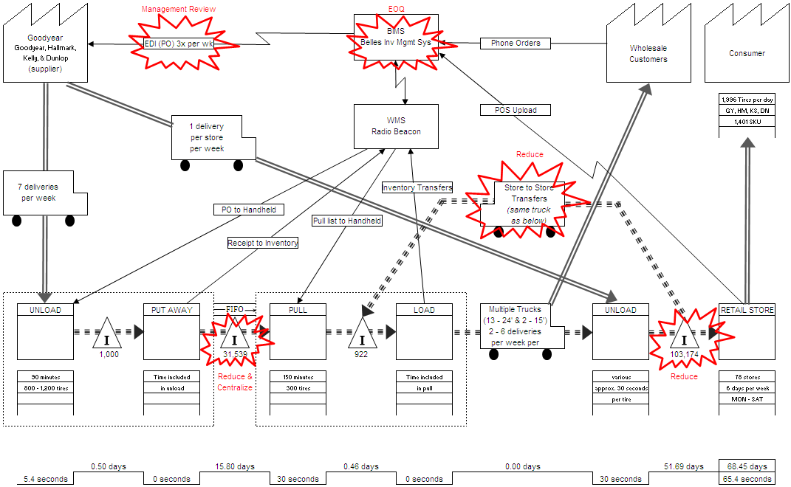
Regional Tire Retail Store Chain
Value stream mapping identifies the bottlenecks

Slide 16
Regional Tire Retail Store Chain
Inventory Management
Client was experiencing liquidity issues and inventory value was increasing
BBK engaged to study inventory processes to identify ways to improve inventory turns
10% of inventory represented 55% of sales volume and client had 55 days supply on hand when 15 days was adequate to meet customer demand
BBK study showed $10 million possible reduction in inventory with no loss in sales. $1.5 million in annual cost savings achieved
$41
Before
$31
After
$12
$10.5
$3.2
$2.9
Inventory
Value
Carrying
Costs
Interest
Expense

Slide 17
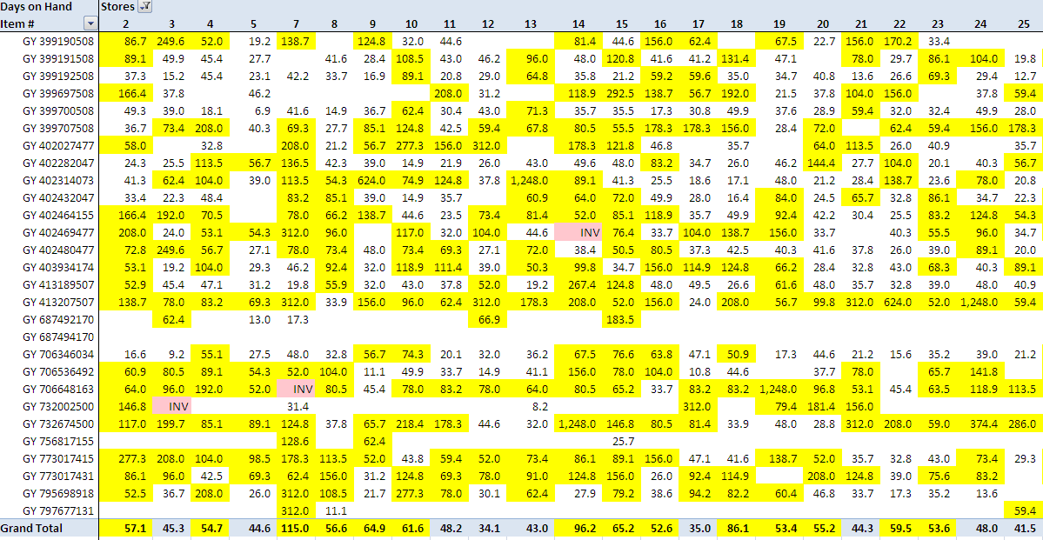
Regional Tire Retail Store Chain
SKU/Days on Hand
Client had over 55 Days of Supply, Only Needs 15 Days

Slide 18
Aerospace Manufacturing
Improve Operating Processes
Client was concerned with the operating performance of a new foundry division producing aircraft parts. The division was losing $250k per month. BBK was hired to create a turnaround plan for the division
BBK created a process flow map that identified several bottle necks and inefficient processes in the production system.
BBK implemented a lean production system around scheduling and staffing to produce stability and limit over production. Daily production metrics were established and closely monitored.
73
712
19%
61
Increased throughput 48%
Reduced inventory 15%
Reduced scrap by 60%
Eliminated one operating shift
Reduced labor and total expense by $2.2 million annually
166
8%
Before
After
Staffing
Overtime
Hrs/Wk
Scrap

Slide 19
Improve Your Incentive Plan

Slide 20
Poll

Slide 21
An Effective Incentive Plan
Clearly linked to company’s strategy and goals
Rewards what is within the scope of influence
Is easily understood and administered
Reflects and supports successful achievement of sales goals

Slide 22
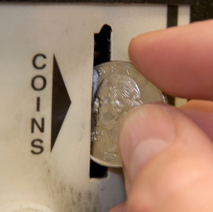
The Art of Sales Compensation
Drives the behavior needed to achieve goals
Differentiates based on results
Is built on realistic but challenging goals
Takes into consideration:
Sales strategy
Prospect buying cycle
Margin based on customer value

Slide 23
Tire Retailer
STORE MANAGER INCENTIVE PLAN
Case Study Discussion
Client had 85 stores
Bonuses were being paid to store managers for achieving sales objectives
Approximately 20 stores were reporting operating losses but store manager was receiving a monthly bonus because he achieved his sales goals
BBK assisted in redesigning the incentive plan to build in sales goals, store profit and effective use of inventory
Ten of the unprofitable stores became profitable over the next 120 days
Get your employees to think like owners

Slide 24
Marketing that Works

Slide 25
Marketing Generates Sales Demand
Inquiries
Marketing
Qualified Leads
Sales-Ready Leads (Prospects)
Sales
Forecasted Opportunities
Closed Business (Customers)

Slide 26
Poll

Slide 27
Marketing Measurements
Activity | Measurement
Events (Actual / virtual) | Response to follow up
Email communications | Open rates, click through rates, replies
Telemarketing | Lead or meeting quality
Direct Mail | Meetings scheduled
Website / SEO | Qualified inquirees
Social Media | Awareness, qualified inquirees
Source: Marketing Sherpa and Aberdeen Research
Notes:
www.nextstepgrowth.com
27

Slide 28
Marketing Your Brand
Value is the reason customers buy
Value-based marketing communicates the company uniqueness
Value to Customer

Slide 29
Measure Your Customer Experience

Slide 30
Understanding your Customers
Executive calls on a quarterly or annual basis
Account manager calls monthly
Value of third party research
Validate marketing approaches
Gather additional buying signals
Test new products
Build testimonials
People like to talk about their experiences

Slide 31
Poll

Slide 32
Customer Experience
Value of a Third Party Assessment
As a standard part of a strategic planning engagement BBK conducts a short telephone interview with key customers of our clients to measure the current customer experience of dealing with our client.
CPA Firm said….we are business advisors to our clients….the clients said………..
Web Designer….we provide excellent customer service….the clients said….

Slide 33
What You Can Do Today
1. Assess your staff and hiring practices
2. Review your processes against your goals
3. Build and align incentive plans with goals
4. Reinvent and measure your marketing
5. Conduct ongoing dialogues with customers
Notes:
Builds start with 1 - 5

Slide 34
Action Plan
I commit to completing the following actions within the month:
Action | Completed By
1.
2.
3.

Slide 35
Questions?
Jennifer Vessels Next Step jvessels@nextstepgrowth.com
James Downes BBK JDownes@e-bbk.com
Notes:
www.nextstepgrowth.com
35

Slide 36
Five Tactics to Increase Business Profitability
Jennifer Vessels Next Step jvessels@nextstepgrowth.com
Robert Muzio Comerica
romuzio@comerica.com
James Downes BBK
JDownes@e-bbk.com
Notes:
Notes
________________________________________________________________________________________________________________________________________________________________________________________________________________________________________________________________________________________________________________________________________________________________________________________________________________________________________________________________________________________________________________________________________________________________________________

